Slide 1

Information Reports
By,
Barsha Pandey
Shrisha Tuladhar
Krisma Maharjan
Anshu Hada

Slide 2
Introduction
By Barsha
2. Summary Abstract and
Mechanism Description
By Shrisha
3. Periodic Report and Progress Report
By Krisma
4. Progress Report Example and
News Release
By Anshu

Slide 3
Introduction
-Barsha

Slide 4
What Is an Information Report?
A report is a carefully researched statement or description of things and events related to a specific issue, problem, or research area.
Focuses on transmitting information with a clear purpose to the intended audience
A good report is formal, accurate, precise, objective, and concise
Includes ideas, procedures, findings, data analysis, conclusions, and recommendations

Slide 5

The Report-Writing Process
Surveying or analyzing a problem
Doing research
Planning the report
Collecting relevant data and information
Preparing the report
Editing and proofreading
Making a final copy

Slide 6
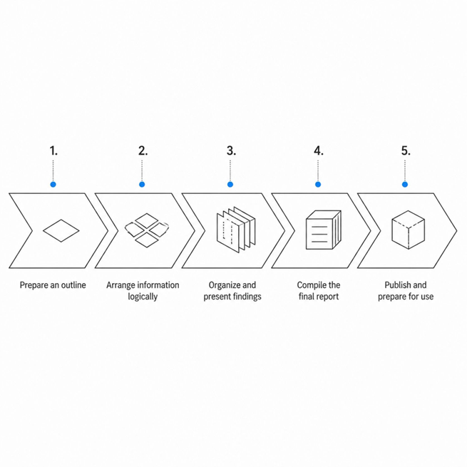
Organizing a Report
Organization depends on the report's length and purpose. The process involves preparing an outline, arranging information logically, and compiling the final document.
Short Reports:
Typically include a title, introduction, body, and conclusion
— concise and direct.
Long Reports:
Span several pages with additional preliminary and supporting
sections for depth and context.

Slide 7
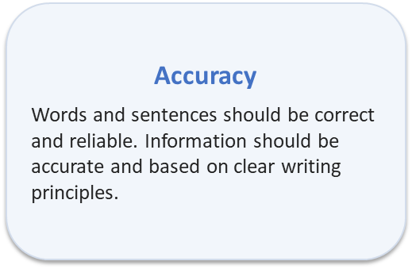
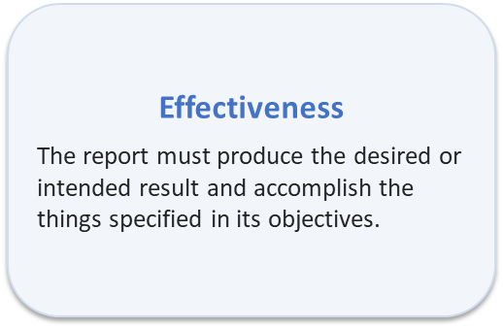
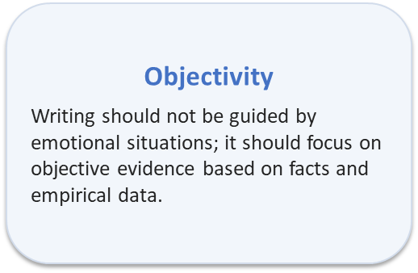
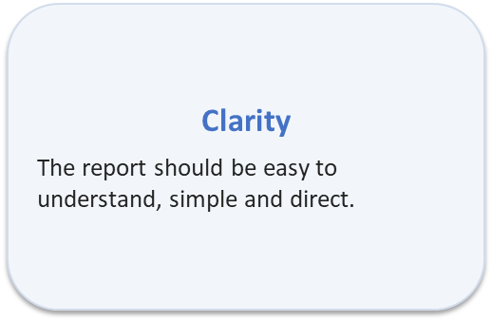
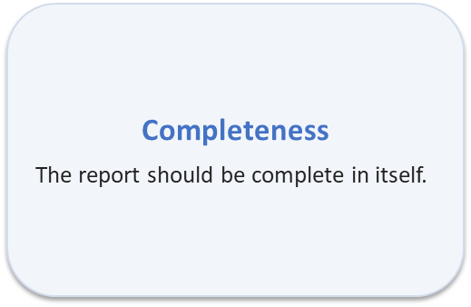
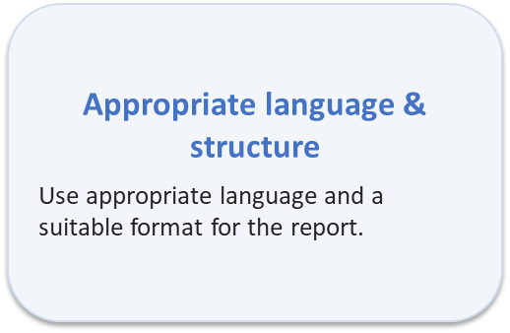
Six Characteristics of a Good Report

Slide 8
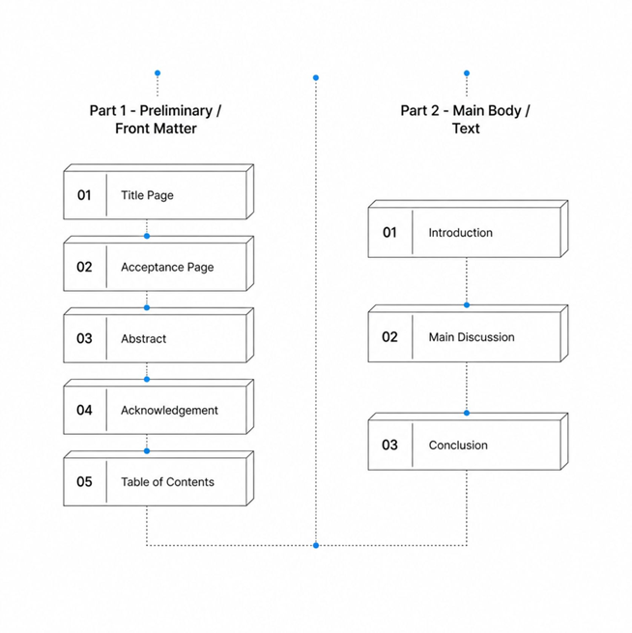
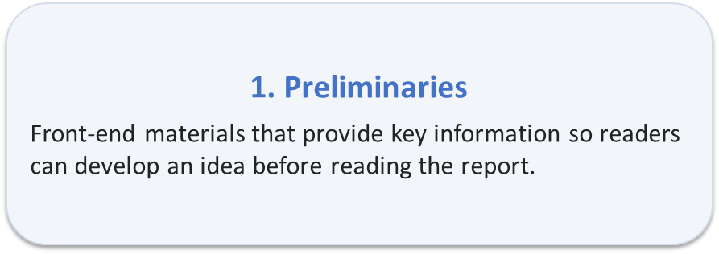
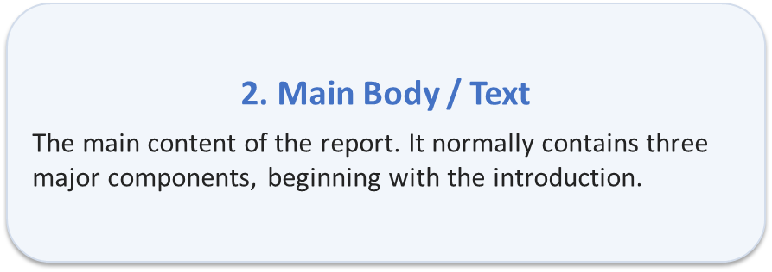
Components of a Formal Report

Slide 9
Preliminary Sections and Main Body
Title page
Acceptance or certification page
Abstract summary
Acknowledgement
Table of contents
Main Body — Three Major Components
Introduction
Explains the main idea, states what the report will express, and prepares readers to follow the information.
2) Main Discussion / Body
Presents findings, analysis, and supporting evidence in a logical
sequence.
3) Conclusion
Summarizes key points and may include recommendations
where required.

Slide 10
Summary and Abstract, Mechanism and Description
- Shrisha

Slide 11
Summary
A summary is a shortened version of a longer document that presents its main ideas and important points.
Steps to write a summary:
Read the original text carefully.
Identify the main idea and key points.
Remove unnecessary details, examples, and repetition.
Rewrite the important information in your own words.
Arrange the ideas logically.
Keep the summary brief and concise.
Check that the original meaning is preserved.

Slide 12
Abstract
An abstract is a brief overview of a report, research paper, or other document. It allows readers to understand the main content without reading the entire work.
Steps to write an abstract:
State the purpose/objective.
Briefly mention the topic or problem.
Mention the method/approach.
Present the main findings/results.
State the conclusion or contribution.
Keep it concise, generally 150–250 words.
Avoid references, citations, and visuals.
Generally use third person and passive voice.

Slide 13
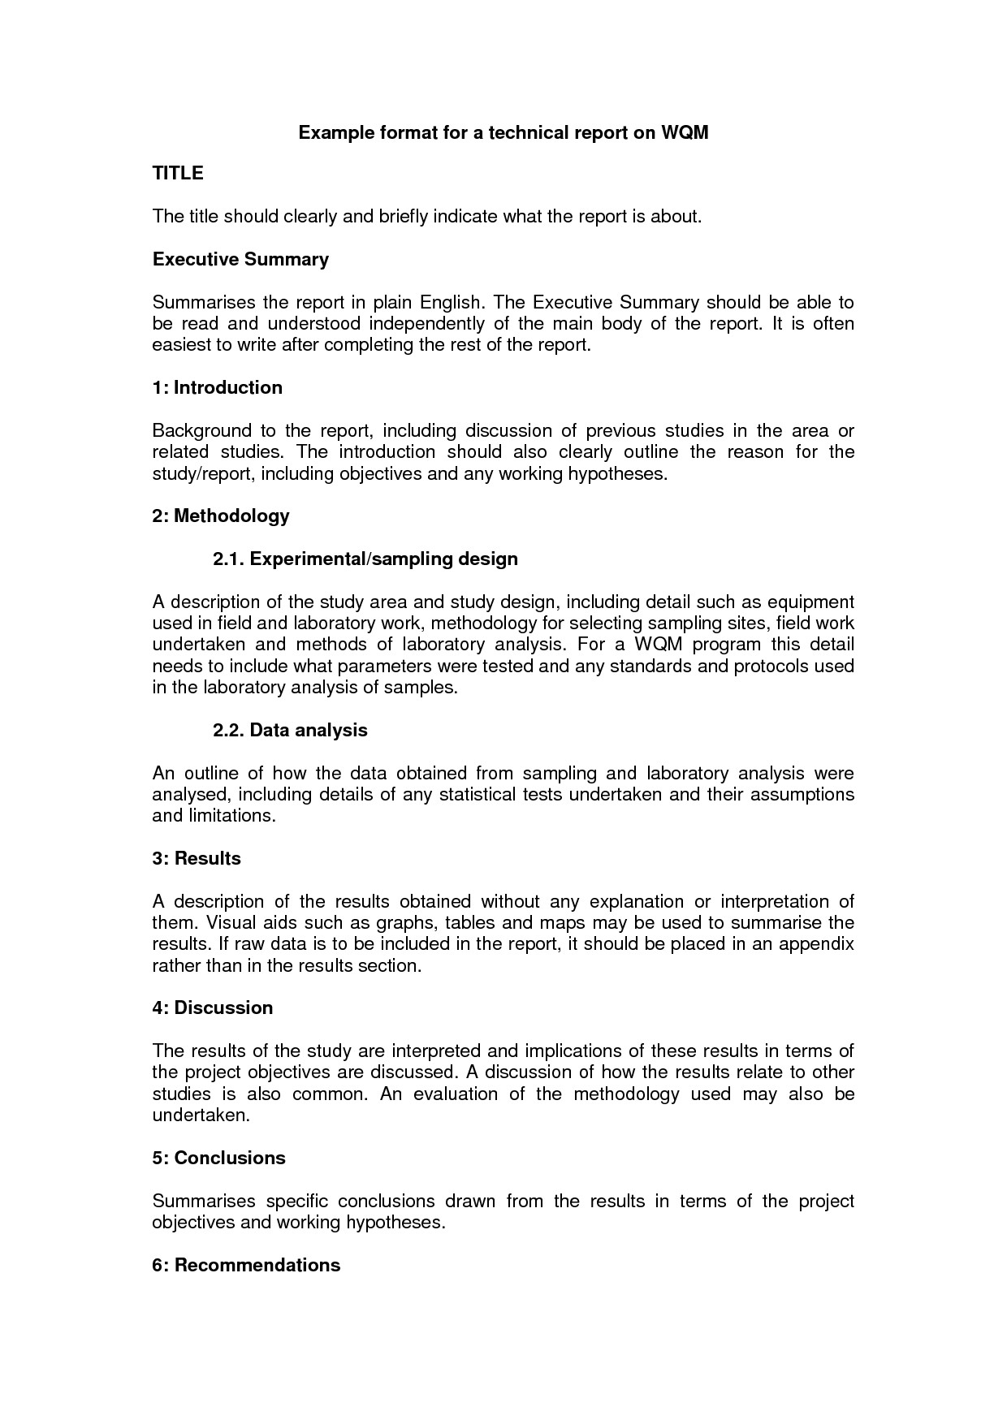
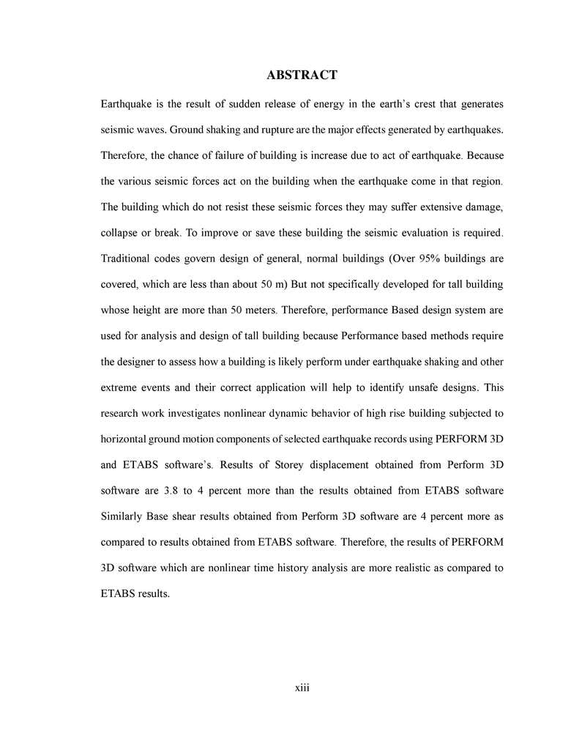
Fig : Summary
Fig : Abstract

Slide 14

Mechanism Description
A mechanism description explains a device, machine, or system by describing its parts, appearance, arrangement, and functions.
It explains:
What the mechanism is
What its purpose is
What its main parts are
What the parts look like
Where the parts are located
What each part does
How the parts work together

Slide 15
Steps for Writing a Mechanism Description:
Identify the mechanism
State the name of the device or system and its main purpose.
Give an overview
Briefly explain what the mechanism does and how it works generally.
Identify the main parts
List the important components of the mechanism.
Describe each part
Explain the appearance, location, and function of each important part.
Explain the relationship between parts
Describe how the different parts are connected and work together.
Explain the operation
Describe how the mechanism works step-by-step, usually in the order in which the process occurs.
Use appropriate visuals
Include a labeled diagram or illustration when it helps the reader understand the mechanism.

Slide 16
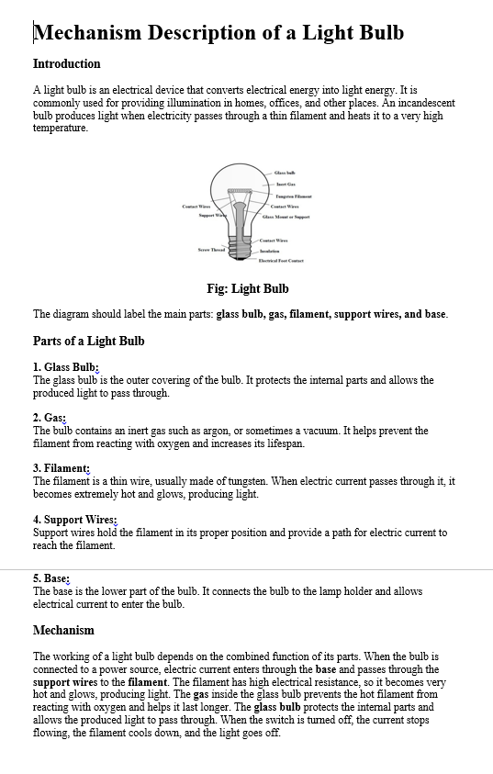
Fig: Mechanism Description

Slide 17
Periodic Report and Progress Report
- Krisma

Slide 18
PERIODIC REPORT
A periodic report is a report prepared at regular intervals to provide information about activities, performance, or results during a specific period.
Common Reporting Periods:
Daily
Weekly
Monthly
Quarterly
Yearly

Slide 19
Purpose of a Periodic Report
A Periodic Report Helps to:
Provide regular updates.
Record activities and achievements.
Monitor performance over time.
Identify problems and areas requiring attention.
Compare current results with previous periods.
Help management make decisions.
Maintain a record of organizational activities.

Slide 20
Basic Format of a Periodic Report
Title / Heading :
Clearly identifies the subject of the report.
Reporting Period :
Specifies the period covered, such as daily, weekly, monthly, or yearly.
Introduction :
Explains the purpose and scope of the report.
Activities / Work Done :
Describes the main activities carried out during the reporting period.
Results / Achievements :
Presents the outcomes, accomplishments, or performance during the period.
Problems / Difficulties :
Describes issues or challenges encountered during the period.
Future Plans :
Explains the activities or goals planned for the next reporting period.
Conclusion :
Summarizes the overall activities and results of the period.

Slide 21
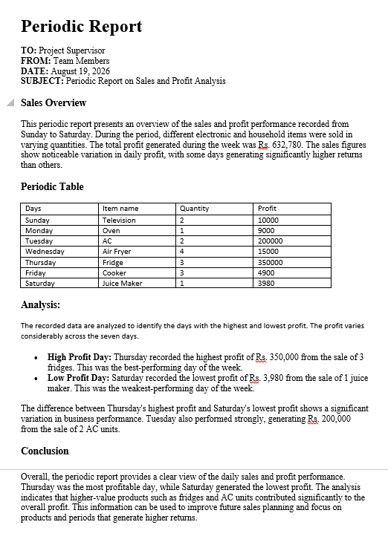
Example of Periodic Report

Slide 22

Progress Report
A progress report is a report that describes the current status and development of a project or activity.
It explains:
What work has been completed
What work is currently in progress
What work remains
Problems encountered during the work
Plans for completing the project

Slide 23
Purpose of a Progress Report:
A Progress Report Helps to:
Monitor the current status of a project.
Measure work against the planned schedule.
Identify delays and problems.
Inform management about the project's condition.
Show whether the project is on schedule.
Plan the remaining work.
Support decision-making.

Slide 24
Basic Format of a Progress Report
Title / Heading:
States the name or subject of the project being reported.
Introduction:
Briefly explains the project, its purpose, and the reporting period.
Work Completed:
Describes the activities and tasks that have already been finished.
Work in Progress:
Explains the tasks that are currently being carried out.
Problems / Difficulties:
Identifies any problems, delays, or challenges affecting the project.
Future / Remaining Work:
Describes the tasks that still need to be completed and the next steps.
Conclusion:
Gives an overall summary of the current progress of the project.

Slide 25
Example of Progress Report and News Release
-Anshu

Slide 26
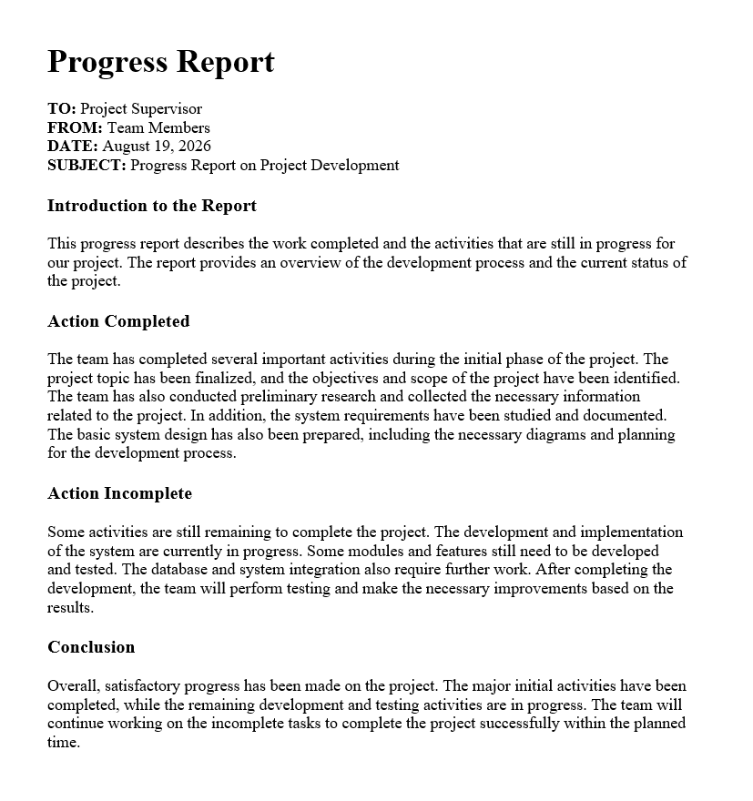
Example of Progress Report :

Slide 27
News Release
A news release, also called a press release, is a report of events or facts prepared for the media.
It is a means of mass communication.
Its main goal is to inform the public.
It may be used to announce employee promotions ,company expansions, important events or facts.
Public Service Announcement (PSA):
PSA is a type of press/news release.
It presents facts that are beneficial to the public.

Slide 28

Purpose and Writing of a News Release
Purpose:
To provide important information to the media and public.
To communicate an organization's activities or position.
To help an organization maintain a positive image.
To provide information that may be considered newsworthy.
Important Writing Points:
A news release should:
Be accurate and complete.
Use correct names and locations.
Maintain credibility.
Include appropriate quotations when necessary.
Have an interesting headline.
Begin with an effective hook/lead.
Present the most important information first.

Slide 29
Basic Format of a News Release
Organization / Letterhead:
Identifies the organization issuing the news release.
Contact Information:
Provides details of the person or office that can be contacted for further information.
Date & Release Instructions:
Shows the date and whether the release is for immediate or later release.
Headline:
A short and interesting title that presents the main news.
Dateline:
Gives the location and date associated with the news.
Lead / Opening:
Presents the most important information and answers the main questions.
Body:
Provides supporting facts, details, background, and quotations.
Ending:
A continued release may use “-more-”, while “-30-” indicates the end.

Slide 30
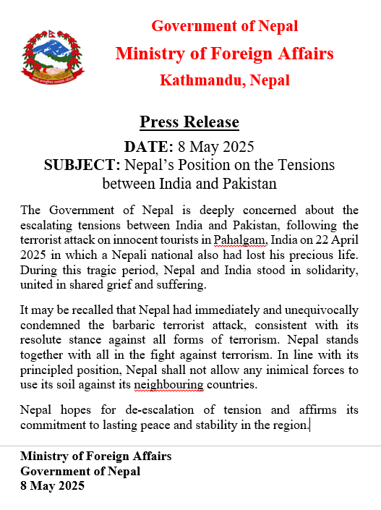
Example of News Release

Slide 31
Conclusion
Information reports present factual information in a clear, organized, and useful manner.
Summaries and abstracts help readers understand the main ideas and essential information quickly.
Mechanism descriptions explain the parts, functions, relationships, and operation of a device or system.
Progress reports show the current status of a project, including completed work, ongoing work, problems, and future activities.
Periodic reports provide regular information about activities, results, and performance during a specific period.
News releases communicate important and newsworthy information to the media and the public.

Slide 32
Thank You!!!

